Slide 1

Introduction to Logic and Computer Design
This class introduces the fundamentals of digital logic design
CSE 3015 디지털 회로 개론 section 2
Chapter 1 digital systems and number systems
Chapter 2 combinational systems
Chapter 3 the Karnaugh map
Chapter 4 designing combinational systems
Chapter 5 analysis of sequential systems
Chapter 6 design of sequential systems
Chapter 7 solving larger sequential systems
1 - <number>
Notes:
디지털 회로 개론을 시작으로 컴퓨터구조, SOC (system-on chip) 디자인, 임베디드 컴퓨터구조로 이어지는 하드웨어 트랙을 수강 할 수 있다

Slide 2
Chapter 1 Digital systems and number systems
Overview
  Digital Systems, Computers, and Beyond
  Information Representation
  Number Systems [binary, octal and hexadecimal]
  Arithmetic Operations
  Base Conversion
  Decimal Codes [BCD (binary coded decimal)]
  Alphanumeric Codes
  Parity Bit
  Gray Codes
1- <number>
Notes:
1장은 Morris Mano의 logic and computer design fundamentals의 내용을 소개한다

Slide 3
Digital systems
Takes a set of discrete information inputs and discrete internal information (system state) and generates a set of discrete information outputs.
Discrete
Discrete
Information
Discrete
Inputs
Processing
Outputs
System
System State
1- <number>

Slide 4

Types of digital systems
No state present
  Combinational Logic System
  Output = Function(Input)
State present
  State updated at discrete times
  => Synchronous Sequential System
  State updated at any time
  =>Asynchronous Sequential System
  State = Function (State, Input)
  Output = Function (State)
  or Function (State, Input)
1- <number>
Notes:
나중에 나오는 combinational logic 과 sequential logic의 구분을 하는 key element

Slide 5
Digital system example
A Digital Counter (e. g., odometer):
Count Up
0
0
1
3
5
6
4
Reset
Inputs:
Count Up, Reset
Outputs:
Visual Display
State:
"Value" of stored digits
Synchronous or Asynchronous?
1- <number>

Slide 6
Digital computer example
Memory
Control
CPU
unit
Datapath
Inputs: keyboard, mouse, wireless, microphone
Outputs:
LCD screen, wireless, speakers
Input/Output
Synchronous or Asynchronous?
1- <number>
Notes:
Answer: Part of specification for a PC is in MHz. What does that imply? A clock which defines the discrete times for update of state for a synchronous system. Not all of the computer may be synchronous, however.

Slide 7
And embedded systems
Computers as integral parts of other products
  Cell phones
  Automobiles
  Video games
  Global Positioning Systems (GPS)
  Smart home electronics
  Smart TV
  Smart phone
1- <number>

Slide 8
Information representation - Signals
Information variables represented by physical quantities.
For digital systems, the variables take on discrete values.
Two level, or binary values are the most prevalent values in digital systems.
Binary values are represented abstractly by:
digits 0 and 1
words (symbols) False (F) and True (T)
words (symbols) Low (L) and High (H)
and words On and Off.
Binary values are represented by values or ranges of values of physical quantities
1- <number>

Slide 9
Signal examples over time
Time
Continuous in value & time
Analog
Digital
Discrete in value & continuous in time
Asynchronous
Synchronous
Discrete in value & time
1- <number>

Slide 10
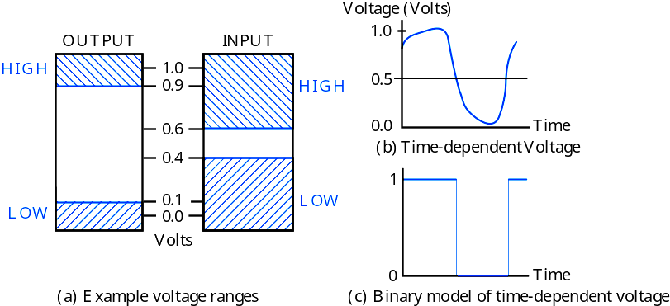
Signal Example – Physical Quantity: Voltage
Threshold Region
1- <number>
Notes:
The HIGH range typically corresponds to binary 1 and LOW range to binary 0. The threshold region is a range of voltages
for which the input voltage value cannot be interpreted reliably as either a 0 or a 1.

Slide 11


Number systems
n : number of digits
r : radix or base
ai : coefficients
Decimal number
Binary number
1- <number>

Slide 12
Number systems example
 | General | Decimal | Binary
Radix (Base) | r | 10 | 2
Digits | 0 => r - 1 | 0 => 9 | 0 => 1
0 1 2 3 Powers of 4 Radix 5 -1 -2 -3 -4 -5 | r⁰ r¹ r² r³ r⁴ r⁵ r ⁻¹ r ⁻² r ⁻³ r ⁻⁴ r ⁻⁵ | 1 10 100 1000 10,000 100,000 0.1 0.01 0.001 0.0001 0.00001 | 1 2 4 8 16 32 0.5 0.25 0.125 0.0625 0.03125
1- <number>

Slide 13
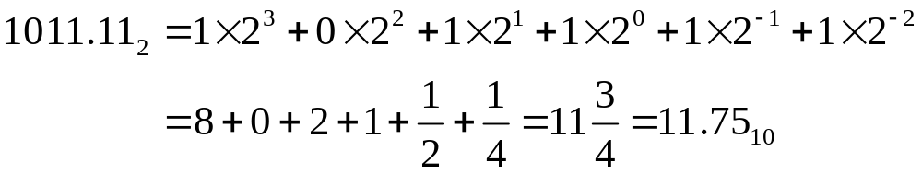
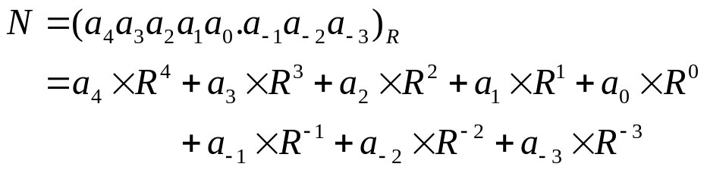
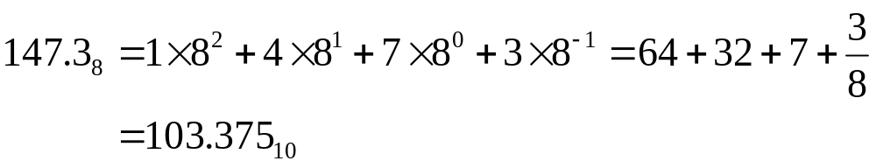
Number systems and Conversion
Decimal:
Binary:
Radix(Base):
Example:
Hexa-Decimal:
1- <number>

Slide 14
Octal and Hexadecimal numbers
Octal number system
8 digits(0 ~ 7)
3-bit string ~ 1 octal digit
100011001110 ₂ = 100 011 001 110 = 4316 ₈
Hexadecimal number system
16 digits(0 ~ 9, A ~ F)
4-bit string ~ 1 hexadecimal digit
100011001110 ₂ = 1000 1100 1110 = 8CE ₁₆
1- <number>

Slide 15
Number system conversions example
binary → octal
10111011001 ₂ = 10 111 011 001 = 2731 ₈
binary → hexadecimal
10111011001 ₂ = 101 1101 1001 = 5D9 ₁₆
binary → decimal
10111011001 ₂ = 1•1024 + 0•512 + 1•256 + 1•128 + 1•64
+ 0•32 + 1•16 + 1•8 + 0•4 + 0•2
+ 1•1 = 1497₁₀
octal → binary
1234 ₈ = 001 010 011 100 ₂
octal → hexadecimal
1234 ₈= 001 010 011 100 ₂ = 0010 1001 1100₂ = 29C₁₆
octal → decimal
1234 ₈ = 1•512 + 2•64 + 3•8 + 4•1 = 668₁₀
hexadecimal → binary
C0DE ₁₆ = 1100 0000 1101 1110 ₂
hexadecimal → octal
C0DE ₁₆ = 1100 0000 1101 1110 ₂
= 1 100 000 011 011 110 ₂ = 140336 ₈
hexadecimal → decimal
C0DE ₁₆ = 12•4096 + 0•256 + 13•16 + 14•1 = 49374₁₀
1- <number>

Slide 16
Representation of negative numbers : signed numbers
Sign-Magnitude Representation
A number consists of tow parts: magnitude and sign
The sign is represented by a single additional bit in binary numbers
sign bit 0 : positive
01010101₂ = + 85₁₀
sign bit 1 : negative
11010101₂ = – 85₁₀
Signed-magnitude system has equal number of positive and negative
integers
Range of n-bits signed-magnitude integer : – (2^{n – 1} –1) ~ + (2^{n – 1} – 1)
Need to compare sign and magnitude when addition and subtraction
→ slower than complement number system
sign bit 0 : positive
0101₂ = + 5₁₀
sign bit 1 : negative
1101₂ = – 5₁₀
1- <number>

Slide 17
Representation of negative numbers : 2’s complement
2’s complement
Two’s Complement
Range of representable number – (2^{n – 1}) ~ + (2^{n – 1} – 1)
Positive number : stored in normal binary
Negative number : 2^{n} – a in n-bit system
Converting steps for negative numbers in two’s complement
Find the binary equivalent of the magnitude
Complement each bit (that is, change 0’s to 1’s and 1’s to 0’s)
Add 1
-5
-1
-0
0101
1010
1
1011
0001
1110
1
1011
0000
1111
1
0000
1- <number>

Slide 18
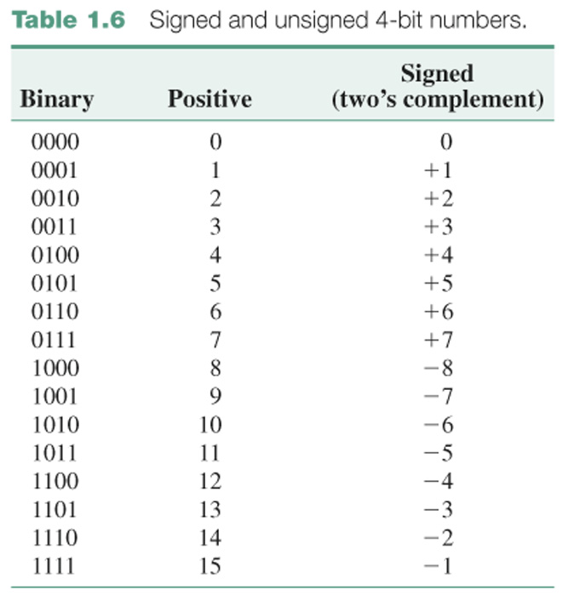
1- <number>

Slide 19
2’s complement addition and subtraction
Addition Rules
4-bit two’s complement additions
3
0011
-2
1110
+
4
+
0100
+
-6
+
1010
7
0111
-8
ignored carry = 1
1000
Overflow
Operation that produces a result that exceeds the range of the number
number system
0100
(+4)
+
0101
(+5)
1001
(-7)
Addition overflow occurs whenever the sign of the sum is different from the
sign of both addends
1- <number>

Slide 20
2’s complement addition and subtraction
Subtraction Rules
4-bit two’s complement subtractions:
complementing the subtrahend and adding the minuend
4
0100
0100
-4
1100
1100
–
3
–
0011
+
1101
–
-8
–
1000
+
1000
1
1 0001
4
1 0100
Two’s complement numbers are added and subtraction using
same procedure(same logic circuit)
1- <number>

Slide 21
Binary Coded Decimal (BCD) Code
Decimal digit | 8421 code | 5421 code | 2421 code | Excess 3 code | 2 of 5 code
0 | 0000 | 0000 | 0000 | 0011 | 11000
1 | 0001 | 0001 | 0001 | 0100 | 10100
2 | 0010 | 0010 | 0010 | 0101 | 10010
3 | 0011 | 0011 | 0011 | 0110 | 10001
4 | 0100 | 0100 | 0100 | 0111 | 01100
5 | 0101 | 1000 | 1011 | 1000 | 01010
6 | 0110 | 1001 | 1100 | 1001 | 01001
7 | 0111 | 1010 | 1101 | 1010 | 00110
8 | 1000 | 1011 | 1110 | 1011 | 00101
9 | 1001 | 1100 | 1111 | 1100 | 00011
unused | 1010 | 0101 | 0101 | 0000 | any of
 | 1011 | 0110 | 0110 | 0001 | the 22
 | 1100 | 0111 | 0111 | 0010 | patterns
 | 1101 | 1101 | 1000 | 1101 | with 0, 1,
 | 1110 | 1110 | 1001 | 1110 | 3, 4, or 5
 | 1111 | 1111 | 1010 | 1111 | 1’s
1- <number>
Notes:
Binary number system is the most natural for a computer, but people are accustomed to the decimal system.
Decimal number -> binary number -> compute -> convert to decimal

Slide 22
Binary Coded Decimal
The BCD code is the 8,4,2,1 code.
  8, 4, 2, and 1 are weights
  BCD is a weighted code
  This code is the simplest, most intuitive binary code for decimal digits and uses the same powers of 2 as a binary number, but only encodes the first ten values from 0 to 9.
Example: 1001 (9) = 1000 (8) + 0001 (1)
How many “invalid” code words are there?
What are the “invalid” code words?
1- <number>
Notes:
Answer 1: 6
Answer 2: 1010, 1011, 1100, 1101, 1110, 1111

Slide 23
BCD addition
Given a BCD code, we use binary arithmetic to add the digits:
8
1000
Eight
+5
+0101
Plus 5
13
1101
is 13 (> 9)
Note that the result is MORE THAN 9, so must be
represented by two digits!
To correct the digit, subtract 10 by adding 6 modulo 16.
8
1000
Eight
+5
+0101
Plus 5
13
1101
is 13 (> 9)
+0110
so add 6
carry = 1
0011
leaving 3 + cy
0001 | 0011
Final answer (two digits)
If the digit sum is > 9, add one to the next significant digit
1- <number>
Notes:
Example) 448 + 489 using BCD addition

Slide 24
Excess 3 Code and 8, 4, –2, –1 Code
Decimal | Excess 3 | 8, 4, –2, –1
0 | 0011 | 0000
1 | 0100 | 0111
2 | 0101 | 0110
3 | 0110 | 0101
4 | 0111 | 0100
5 | 1000 | 1011
6 | 1001 | 1010
7 | 1010 | 1001
8 | 1011 | 1000
9 | 1100 | 1111
What interesting property is common to these two codes?
1- <number>
Notes:
Answer: Both of these codes have the property that the codes for 0 and 9, 1 and 8, etc. can be obtained from each other by replacing the 0’s with the 1’s and vice-versa in the code words. Such a code is sometimes called a complement code.

Slide 25
Warning: Conversion or Coding?
Do NOT mix up conversion of a decimal number to a binary number with coding a decimal number with a BINARY CODE.
13₁₀ = 1101₂ (This is conversion)
13 ⇔ 0001|0011 (This is coding)
1- <number>

Slide 26
Gray code
  Consecutive numbers differ in only one bit
  Useful in coding the position of a continuous device
Number | Gray code | Number | Gray code
0 | 0000 | 8 | 1100
1 | 0001 | 9 | 1101
2 | 0011 | 10 | 1111
3 | 0010 | 11 | 1110
4 | 0110 | 12 | 1010
5 | 0111 | 13 | 1011
6 | 0101 | 14 | 1001
7 | 0100 | 15 | 1000
1- <number>

Slide 27



Hamming Code
  By Richard Hamming in 1950
  Single error correction code
  4 data bits and 3 check bits
  The check bit is chosen so that the total number of 1’s in the bits selected is even
 | a1 | a2 | a3 | a4 | a5 | a6 | a7
Bit 1 | X |  | X |  | X |  | X
Bit 2 |  | X | X |  |  | X | X
Bit 3 |  |  |  | X | X | X | X
1- <number>

Slide 28
Hamming code
Date/Bit | a1 | a2 | a3 | a4 | a5 | a6 | a7
0000 | 0 | 0 | 0 | 0 | 0 | 0 | 0
0001 | 1 | 1 | 0 | 1 | 0 | 0 | 1
0010 | 0 | 1 | 0 | 1 | 0 | 1 | 0
0011 | 1 | 0 | 0 | 0 | 0 | 1 | 1
0100 | 1 | 0 | 0 | 1 | 1 | 0 | 0
0101 | 0 | 1 | 0 | 0 | 1 | 0 | 1
0110 | 1 | 1 | 0 | 0 | 1 | 1 | 0
0111 | 0 | 0 | 0 | 1 | 1 | 1 | 1
1000 | 1 | 1 | 1 | 0 | 0 | 0 | 0
1001 | 0 | 0 | 1 | 1 | 0 | 0 | 1
1010 | 1 | 0 | 1 | 1 | 0 | 1 | 0
1011 | 0 | 1 | 1 | 0 | 0 | 1 | 1
1100 | 0 | 1 | 1 | 1 | 1 | 0 | 0
1101 | 1 | 0 | 1 | 0 | 1 | 0 | 1
1110 | 0 | 0 | 1 | 0 | 1 | 1 | 0
1111 | 1 | 1 | 1 | 1 | 1 | 1 | 1
1- <number>

Slide 29

Hamming code example
  Received : 0010011
    e1 = 0 e2 = 1 e4 = 0
    bit 2(check bit) error => a2 = 1
    Correct word : 0110011, Data : 1011
  Received : 1101101
    e1 = 1 e2 = 0 e4 = 1
    bit 5 error => a5 = 0
    Correct word : 1101001, Data : 0001
  Checking 4e4 + 2e2 + e1 for finding error bit
For n check bit, there can be information bits
1- <number>

